Slide 1
Railway Track Cleaning Robot
Dharik Anwar - 132001002
Hrishikesh - 132001015
Mentor- Dr. Santhakumar Mohan

Slide 2
Introduction
Cleaning the rail track at the railway station is one of the major tasks in India. Currently, the cleaning is done through manually and it is quite dirty.
Manual scavenging is time consuming and require more manpower.
There are automated vehicles existing for these purposes and they are mostly imported and expensive.

Slide 3
Objective
Cleaning the tracks near to the platform.
-To remove the solid wastes (plastic bottles , wrappers, packets …etc) .
-To wash the track with high pressure water sprinklers.

Slide 4
Design Concept Idea
Vacuum duct
Storage Tank
Wastes
Water Sprinkler
Brushes

Slide 5
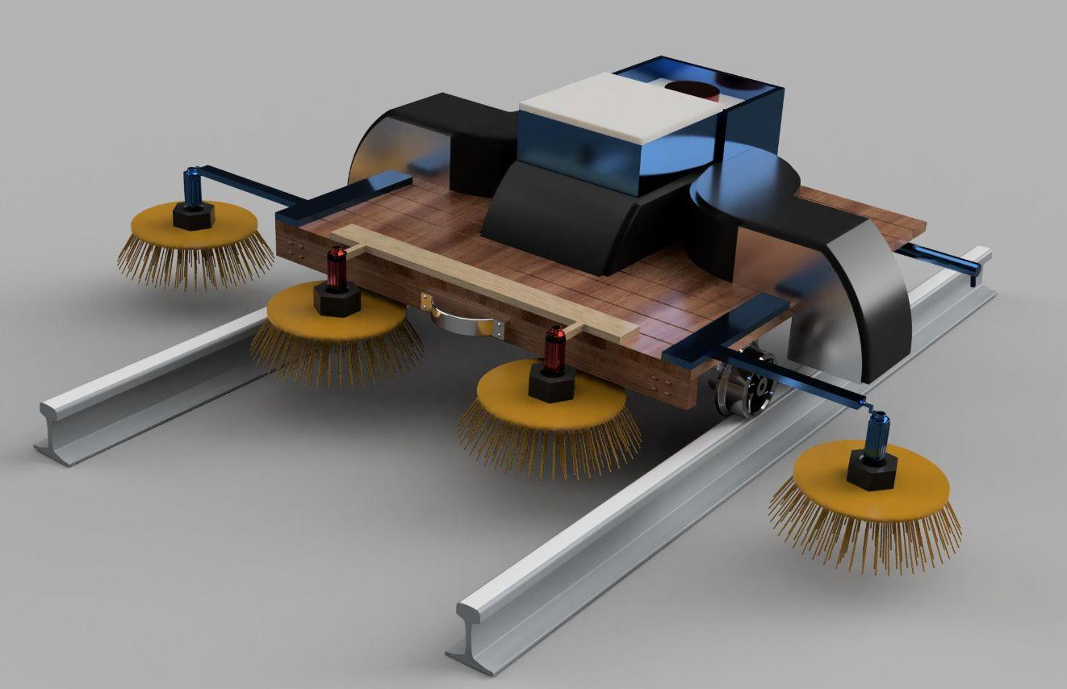
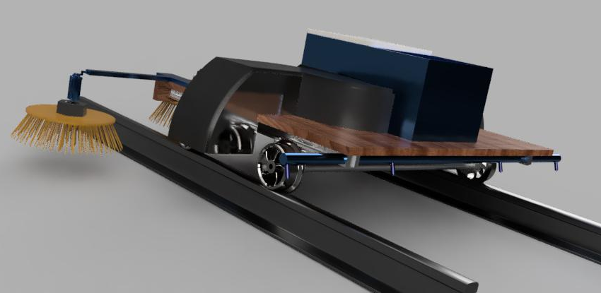
Design Progress
-CAD (Fusion 360- Model )

Slide 6
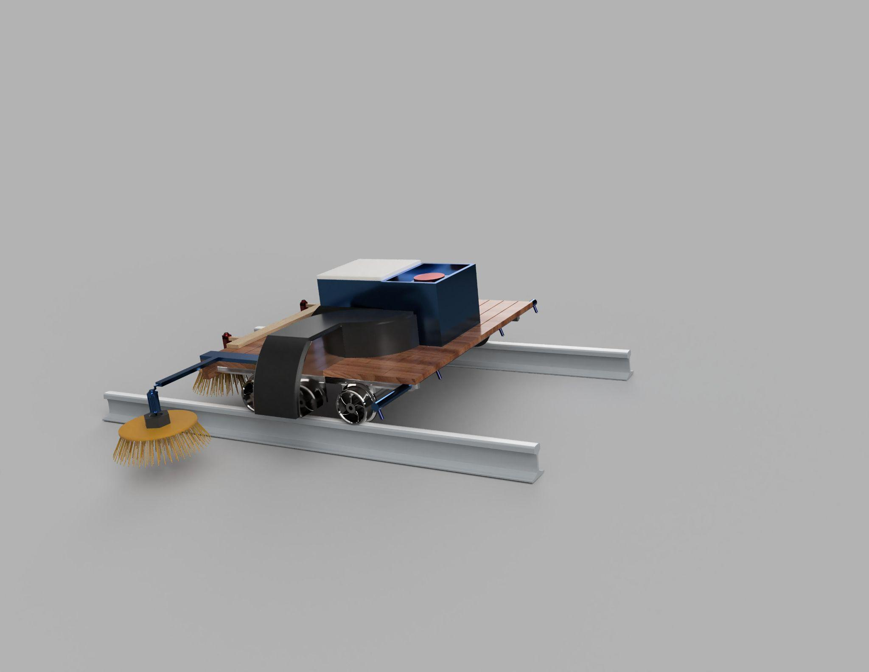

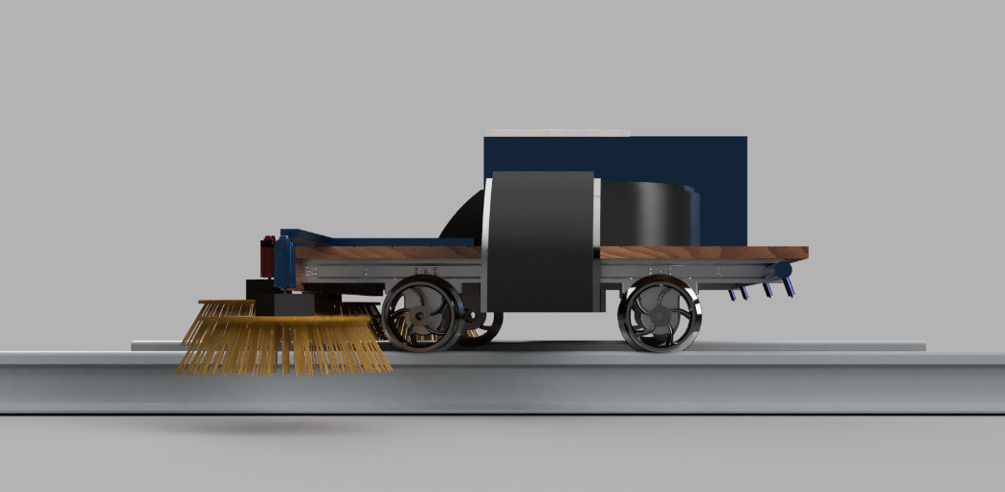

Slide 7
Components
DC geared motors
60 rpm - 4 No
45 rpm - 2 No
High speed motor - 1 No
Circular Brushes - 4 No - 8 inch Diameter
Impeller - 6 inch diameter x 3 inch height
Aluminium Frames
20x20
30x30
Vacuum Duct
Fixed Castor Wheels - 2 No - 3 inch wheel diameter
Motor shaft Wheels - 2 No - 4 inch diameter

Slide 8
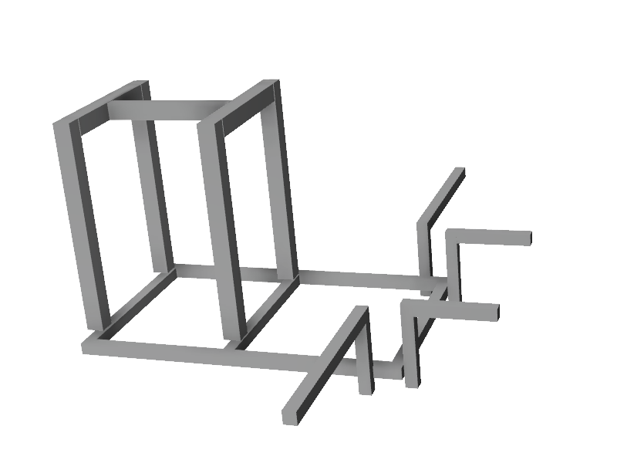
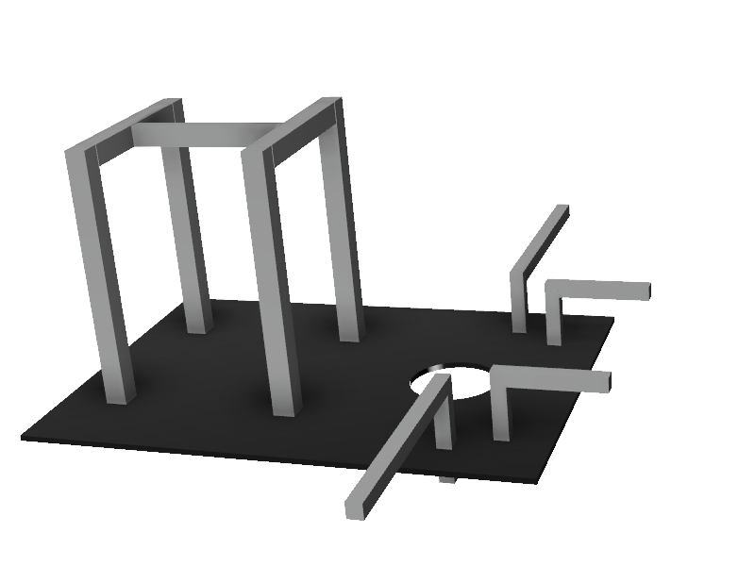
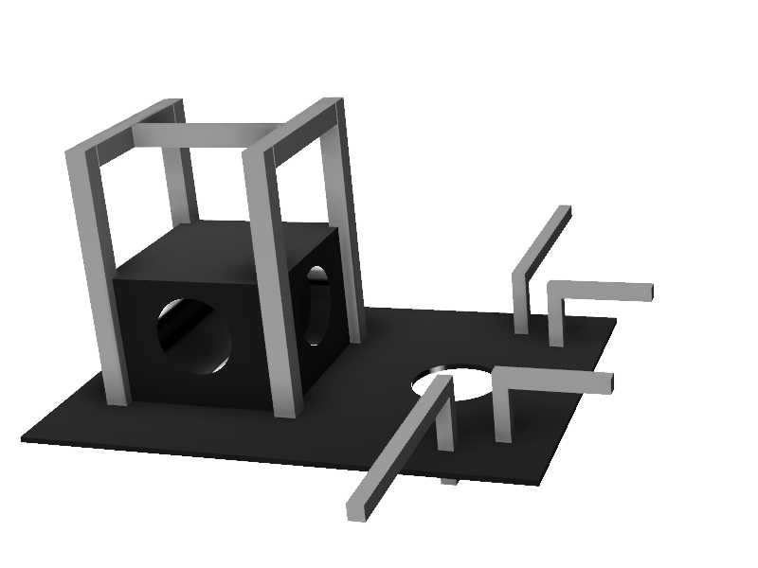
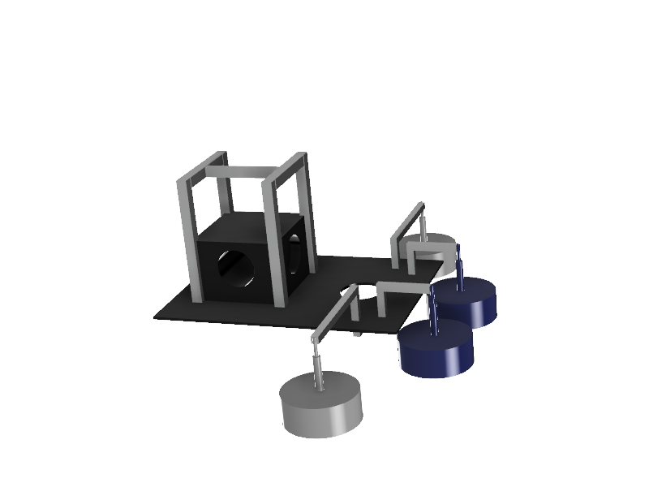
Prototype
Frame Structure
Base Frame
Storage Tank
Brushes

Slide 9
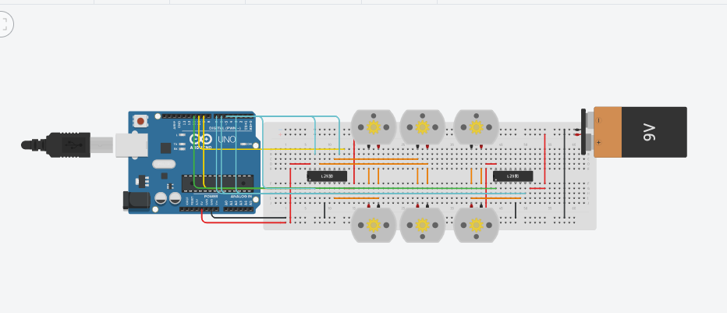
Circuit Diagram

Slide 10
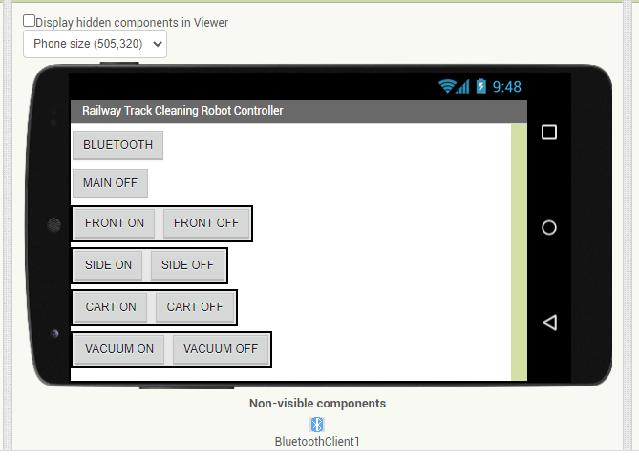
Bluetooth Control
Control the robot via bluetooth using an app from mobile

Slide 11
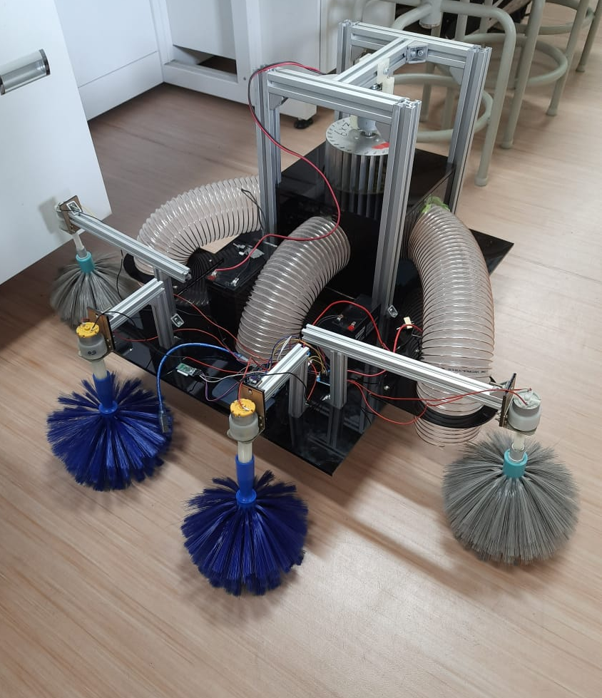
Prototype
Vacuum Impeller
Vacuum duct
Sweeper

Slide 12
Result and Conclusion
The sweeper mechanism was successful in gathering the solid waste.
The Bluetooth control was successful, the test for the 4 sweepers which are connected to Bluetooth.
The vacuum pump was tested and it gives the result as, it can able to suck lightweight wastes like small papers, polythene covers and some lightweight materials.

Slide 13
Future Plans
Addition of high-speed water jet nozzles to clean sticky and wet waste.
Implementation of wireless control of vacuum pressure, water pump power and cart speed.
Addition of image processing to detect and identify wastes and control the sweepers and vacuum according to the need.
Adding object detection sensors for an emergency stoppage in case of an obstacle.

Slide 14
THANK YOU

